Slide 1
Utilizing Machine Learning to Predict Epileptic Seizures
K. Beerensson, J. Bello, N. Hincapie, R. Lomaglio, R. Mcgary, S. Smoke

Slide 2
Project Overview
EEG Processing for Epilepsy Prediction
Goal:
Train a model that can identify distinctive features in EEG signals associated with seizure events
We used:
Supervised learning model for classification (Random Forest Classifier)
A subset of an epileptic seizure EEG dataset sourced from CHB-MIT
Dataset included a set of both time domain and frequency domain features extracted from raw EEG signals collected from 24 subjects

Slide 3
Problem & Significance
Epilepsy affects 65 million people worldwide and 125,000 die every year
Manual interpretation of EEG data is time-consuming and can delay diagnosis and treatments
This project addresses the biomedical challenge of automating epileptic seizure detection and improving accuracy using machine learning techniques

Slide 4
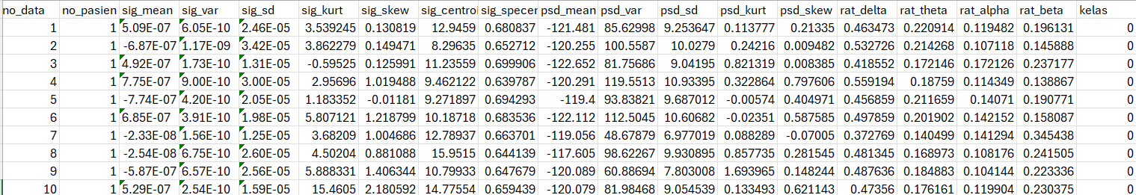
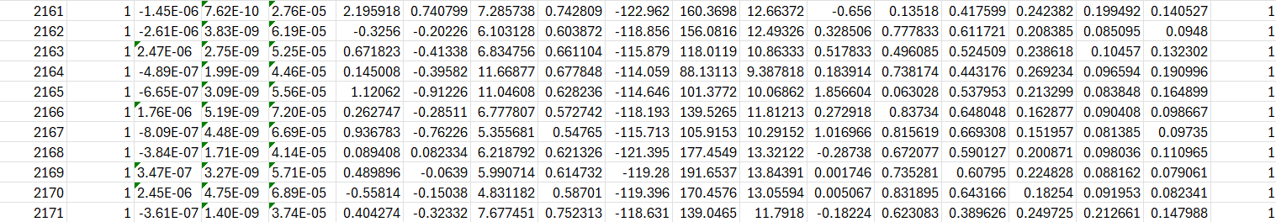
Data
80/20 train-test split
473 test points in class 0, 392 test points in class 1 (out of a total of 4321 samples)

Slide 5
Methodology
Denoise
Train
Diagnose
Dataset was partly preprocessed prior to training the model, our code scaled the features and split up data into a training set and testing set
Trained the model to be capable of classifying unseen EEG signal data into two categories (Seizure Activity and No Seizure Activity) based on patterns in the training data
Our trained model is intended to be capable of detecting seizure activity from an unseen set of EEG data

Slide 6
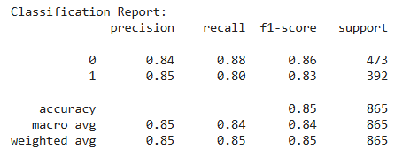
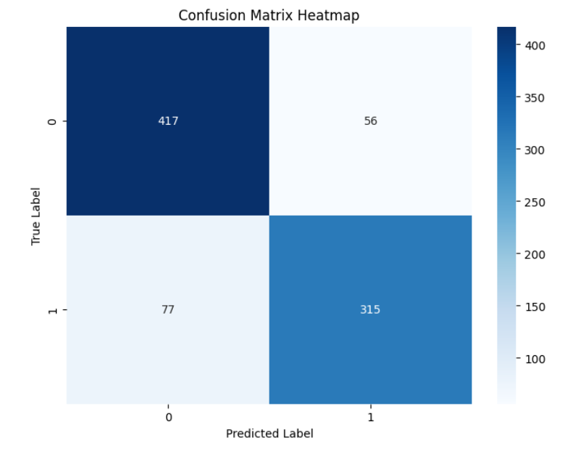
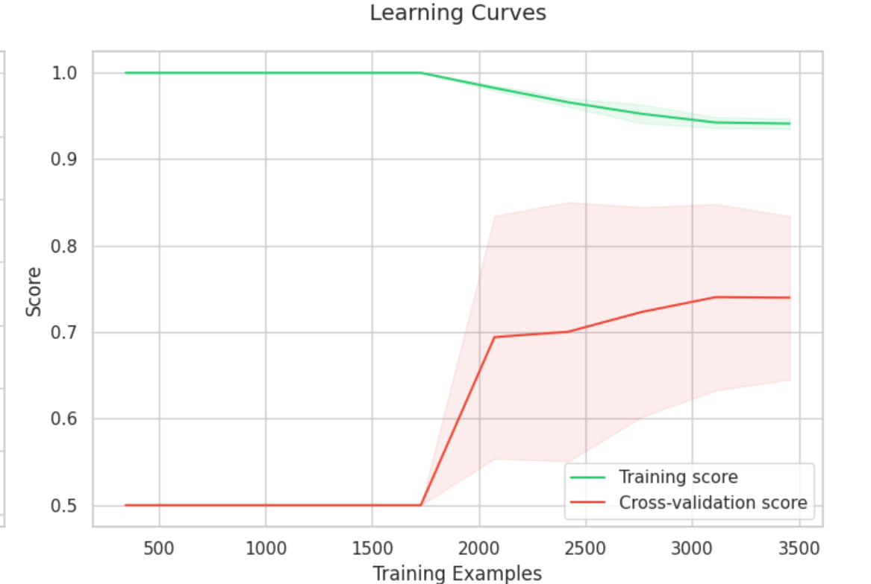
Results

